Slide 1
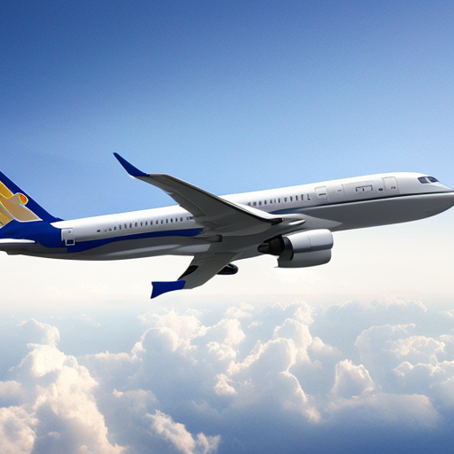

AIRLINE DELAY ANALYSIS
Group 4: DATA 228
Big Data Technologies & Applications
Prof. Sangjin Lee

Slide 2
CONTENTS
PROBLEM STATEMENT
GOAL AND OBJECTIVE
DATA SOURCE & DESCRIPTION
DATA OVERVIEW
DATA PROCESSING
HDFS / AWS S3 AS A STORAGE
SPARK AS DISTRIBUTED DATA PROCESSING
ANALYSIS AND INSIGHTS
DASHBOARD
K-MEANS AND LOGISTIC REGRESSION ANALYSIS
CONCLUSION
FUTURE SCOPE

Slide 3

PROBLEM STATEMENT
AIRPORT AND ROUTE DELAY HOTSPOTS
Identify airports and flight routes with the highest average delays over time, and analyze spatial and temporal delay patterns
WEATHER IMPACT ON FLIGHT DISRUPTIONS
Quantify the influence of weather-related variables (e.g., wind speed, visibility, precipitation) on flight delays
AIRLINE ON-TIME PERFORMANCE BENCHMARKING
Compare the on-time performance of major airlines across regions to highlight carriers with consistently high or low delay rates

Slide 4
GOAL AND OBJECTIVE
IDENTIFY KEY DELAY PATTERNS
BENCHMARK AIRLINE PERFORMANCE
ASSESS EXTERNAL IMPACT FACTORS
SUPPORT DATA-DRIVEN DECISION MAKING

Slide 5
DATA SOURCE AND DESCRIPTION
FLIGHT DATA:
SOURCE: United States Bureau of Transportation Statistics - DataSource
Time Period: Jan 2020 to Dec 2024
Total Records: 31,339,836 rows (~31 Million) more than 13GB data size
KEY ATTRIBUTES: FlightDate, Airline, Origin, Dest, DepDelay, ArrDelay, Cancelled, Diverted
WEATHER DATA :
SOURCE: Historical weather data via Meteostat
Time Period: Jan 2024 to Dec 2024
WEATHER FEATURES: Precipitation, Wind Speed, Temperature

Slide 6
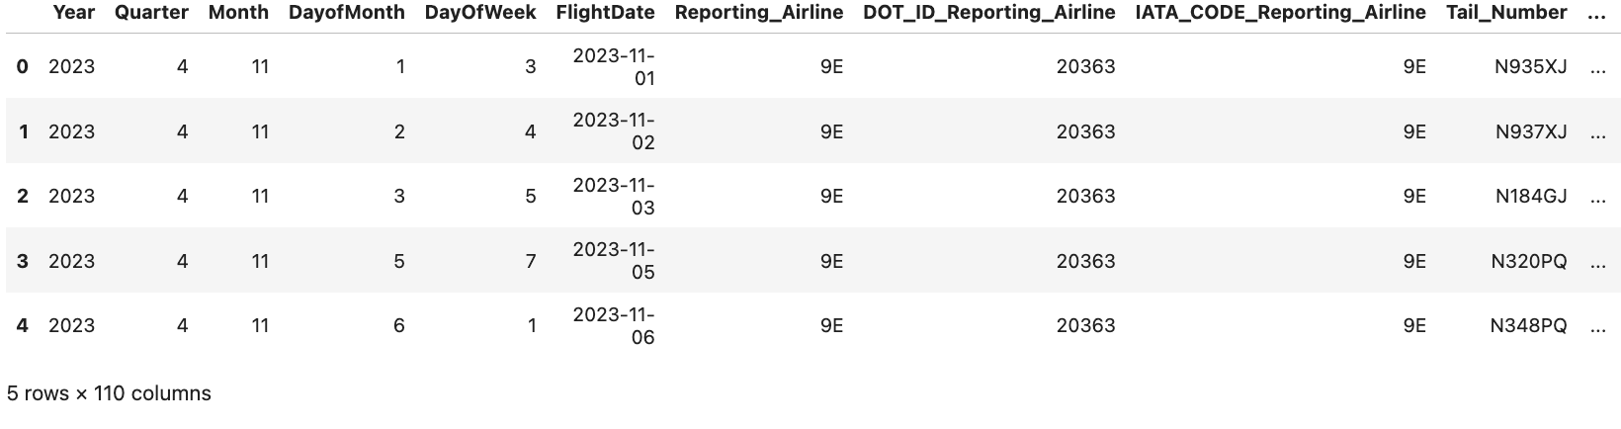

DATA OVERVIEW

Slide 7
DATA PROCESSING
DATA INGESTION
DATA PREPROCESSING
DATA ENRICHMENT
FEATURE ENGINEERING
PARTITIONING AND STORAGE

Slide 8
HDFS/AWS S3 AS A STORAGE FILESYSTEM
Store raw flight performance CSV files (multi-GB scale)
Store weather data from external sources (daily/hourly)
Input source for Spark jobs that clean, transform, and analyze data
Intermediate storage for joined/enriched datasets (flight + weather)
Final outputs (aggregated tables, dashboards) are written back to HDFS
AWS S3 was also used for backup storage and cloud-accessible data exchange

Slide 9
SPARK – DISTRIBUTED DATA PROCESSING
Processes data stored in HDFS using parallel computing
Handles data cleaning and filtering (e.g., removing nulls, filtering flights)
Joining flight and weather datasets
Aggregations and transformations (e.g., delay rate per airline)
Output tables for dashboards and insights

Slide 10
ML MODELING: CLUSTERING & WEATHER DELAY PREDICTION
K-MEANS CLUSTERING:
Segments routes based on delay behavior
Identifies high-delay clusters using flight and temporal features
LOGISTIC REGRESSION (PYSPARK):
Predicts weather-related flight delays (binary flag)
Uses encoded route info and weather conditions
Built via Spark ML pipeline (80/20 split)

Slide 11
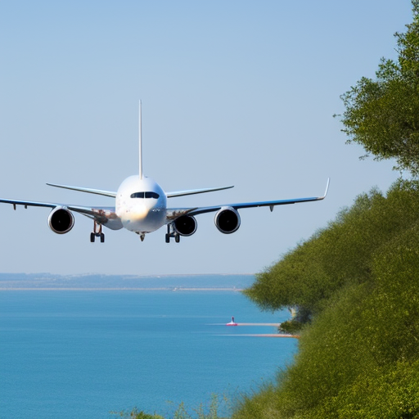
ANALYSIS AND INSIGHTS

Slide 12
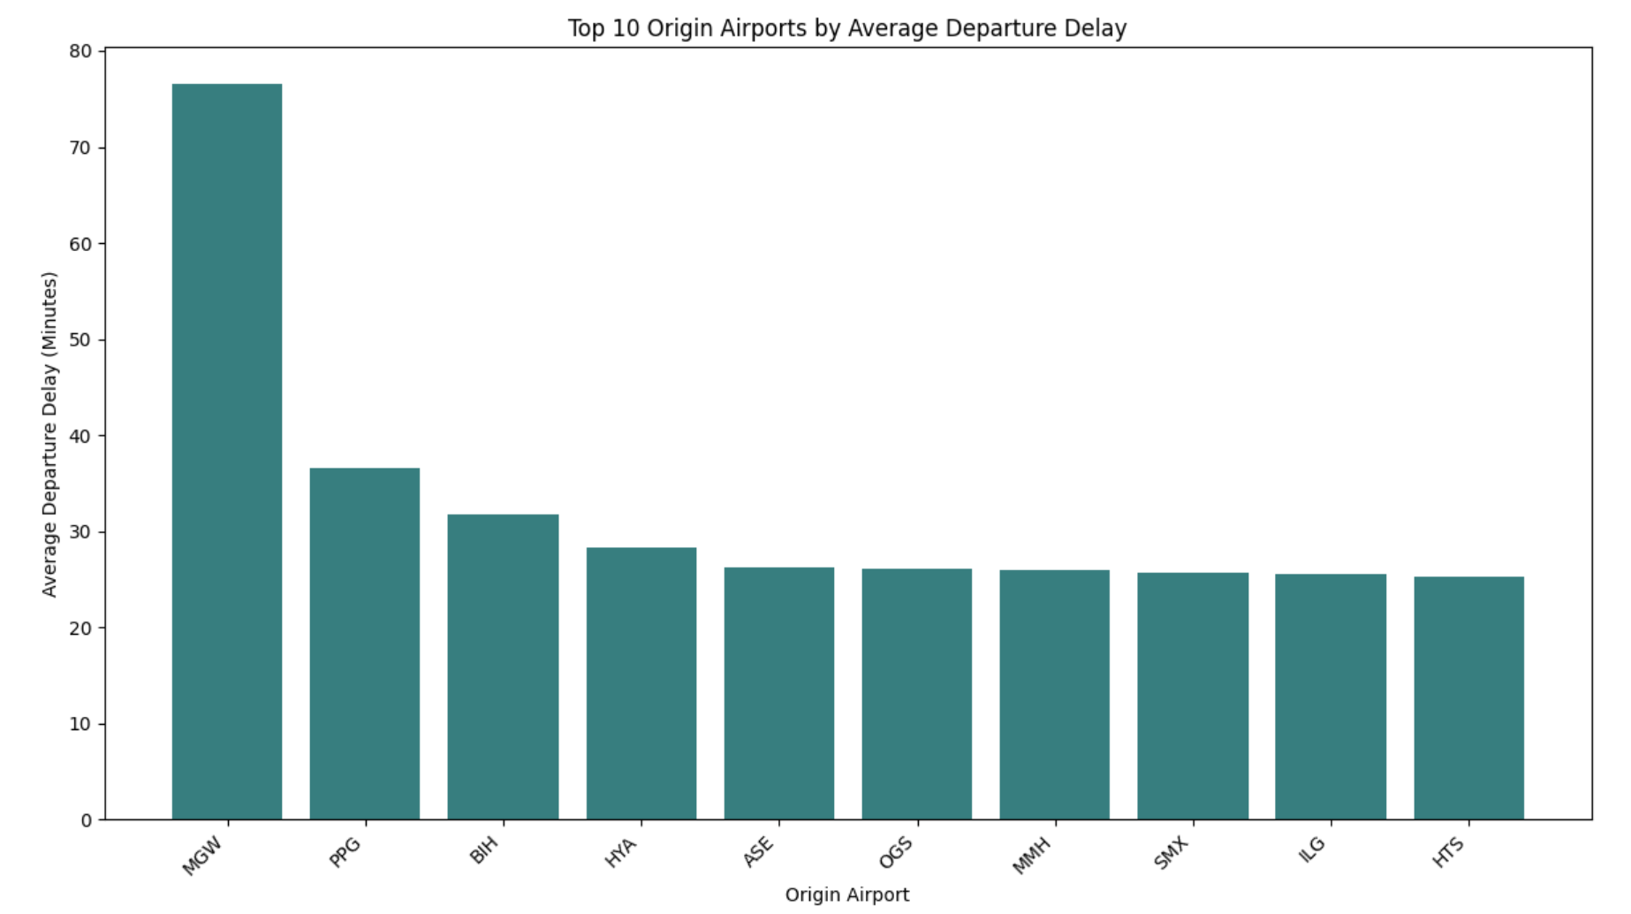
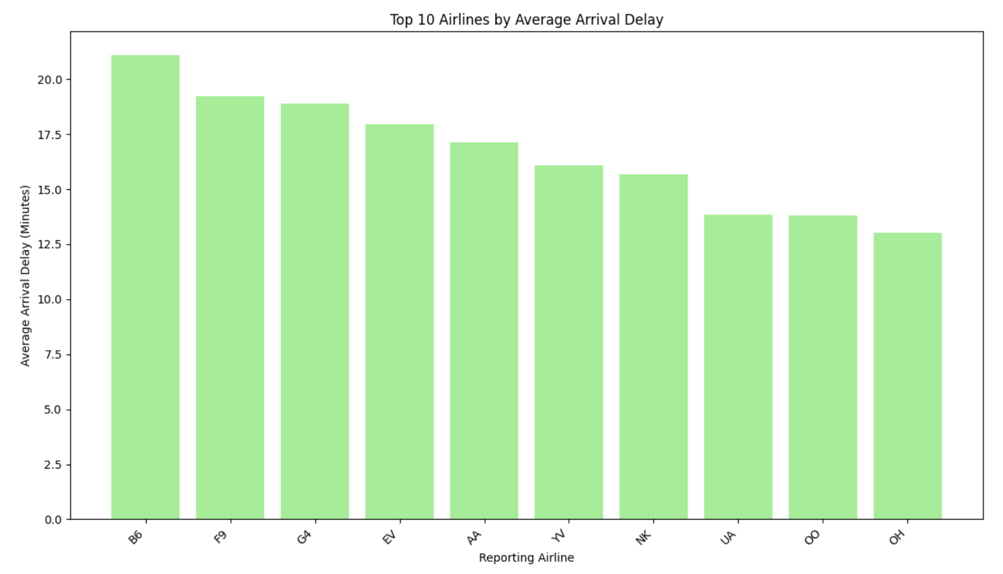
DELAY HOTSPOTS
Morgantown (MGW) leads with the longest average departure delays.
Other airports like PPG and BIH show moderate but consistent delays.
JetBlue (B6) and Frontier (F9) have the highest arrival delays.
SkyWest (OO) and PSA Airlines (OH) show better on-time performance.

Slide 13
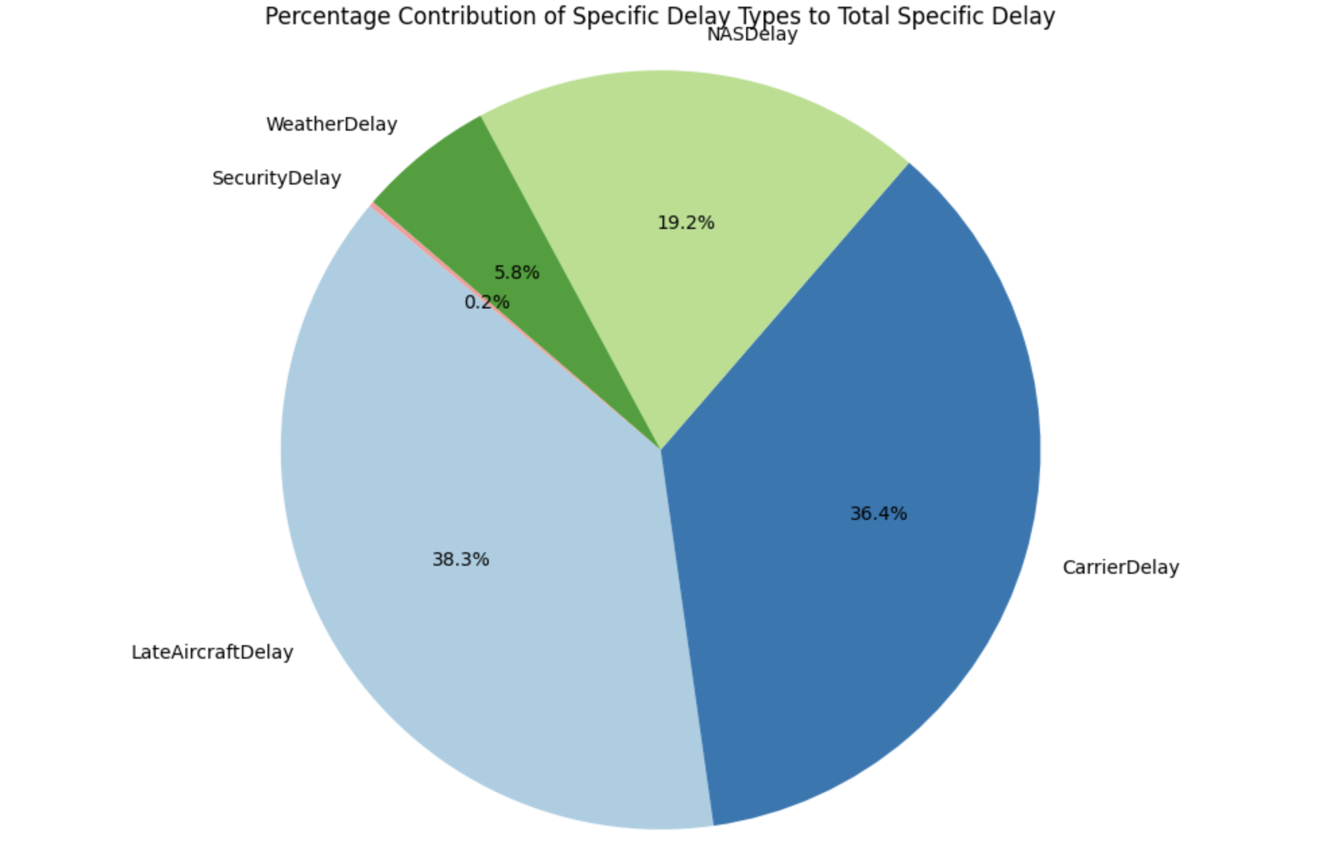
DELAY CAUSES
Late aircraft is the top delay cause, showing ripple effects from earlier flights.
Carrier delays come next, linked to airline-specific issues.
NAS delays reflect airspace and traffic control problems.
Weather delays are smaller but still significantly affect operations.

Slide 14
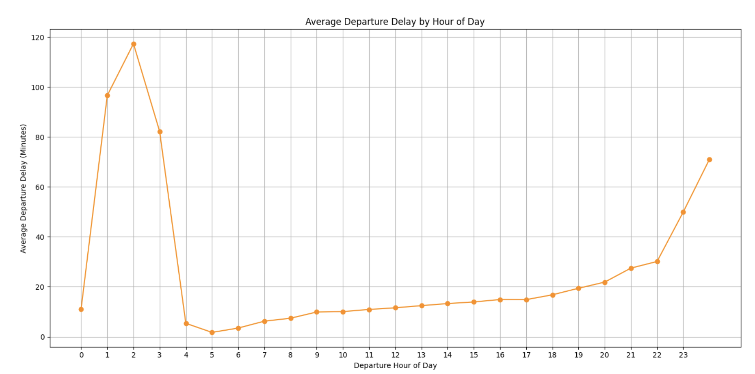
AIRLINE ON-TIME PERFORMANCE
Peak delays occur between 1–3 AM, with the highest around 2 AM (~118 mins).
Early morning flights (5–8 AM) have the lowest average departure delays.
Delays gradually increase through the day, rising steadily after noon.
Late night flights (10–11 PM) show a noticeable spike, likely due to accumulated system delays.

Slide 15
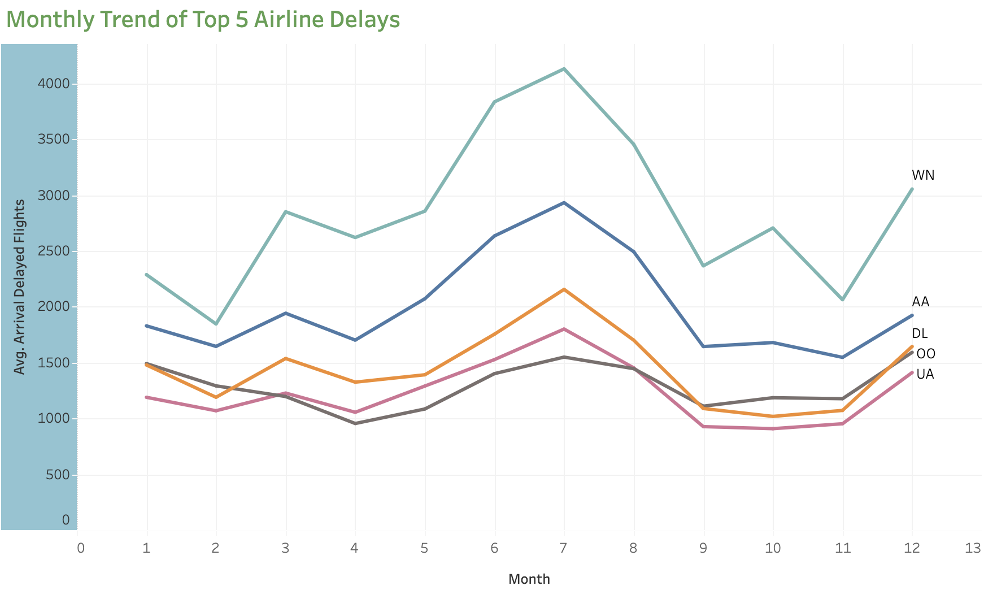
MONTHLY FLIGHT DELAY TRENDS
Delay peaks occur during July and August, indicating heavy summer travel congestion
Airlines like WN (Southwest) and AA (American Airlines) show the highest seasonal variation in total delay minutes
A notable drop in delays is observed from September to November, likely due to reduced passenger traffic and weather improvements.

Slide 16
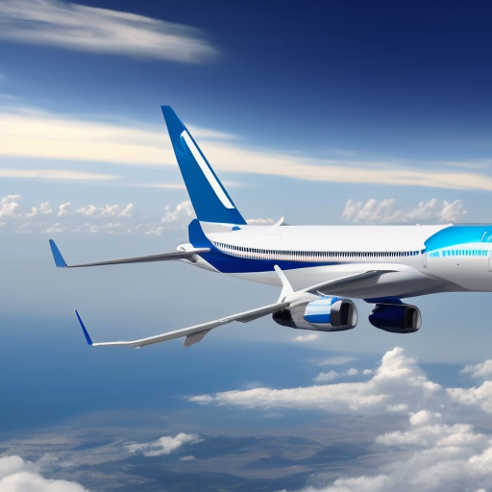
DASHBOARD

Slide 17
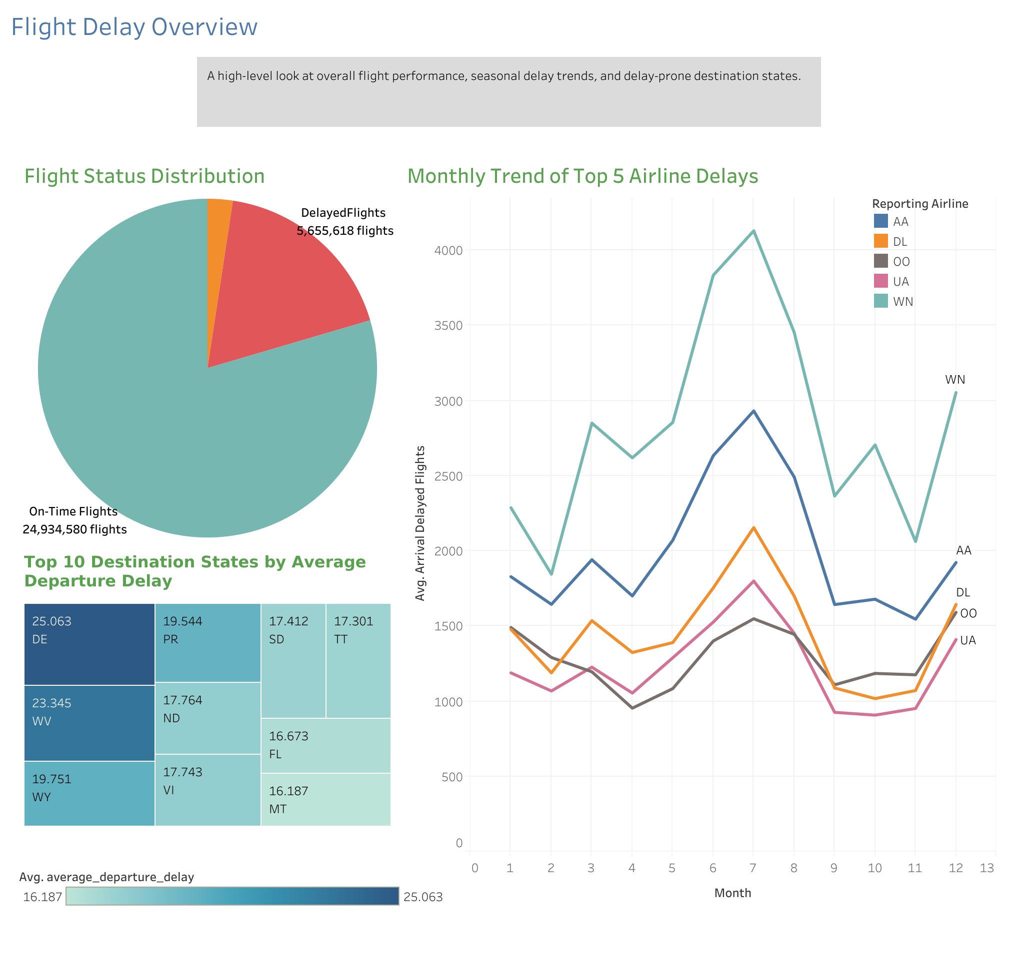
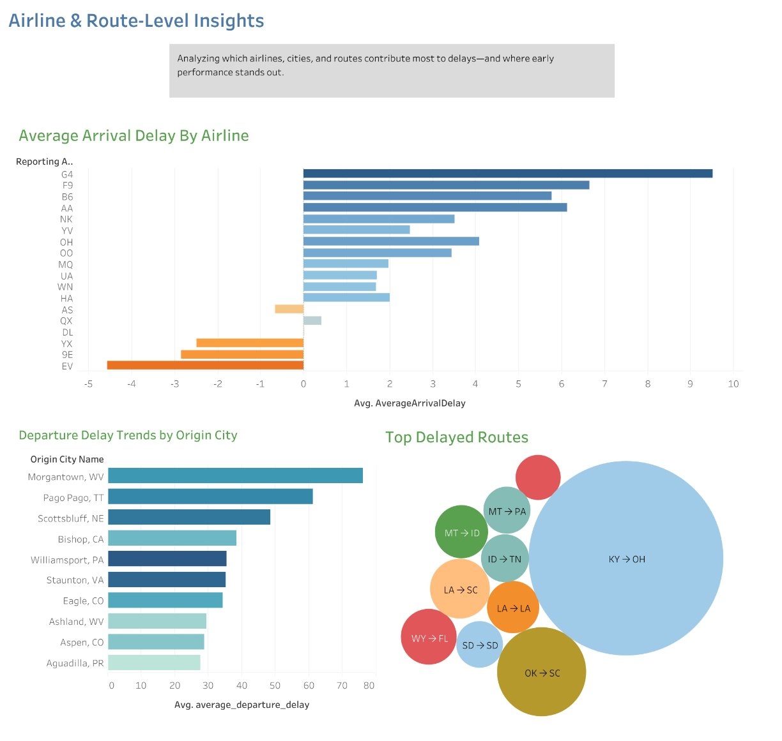
DASHBOARD OVERVIEW

Slide 18
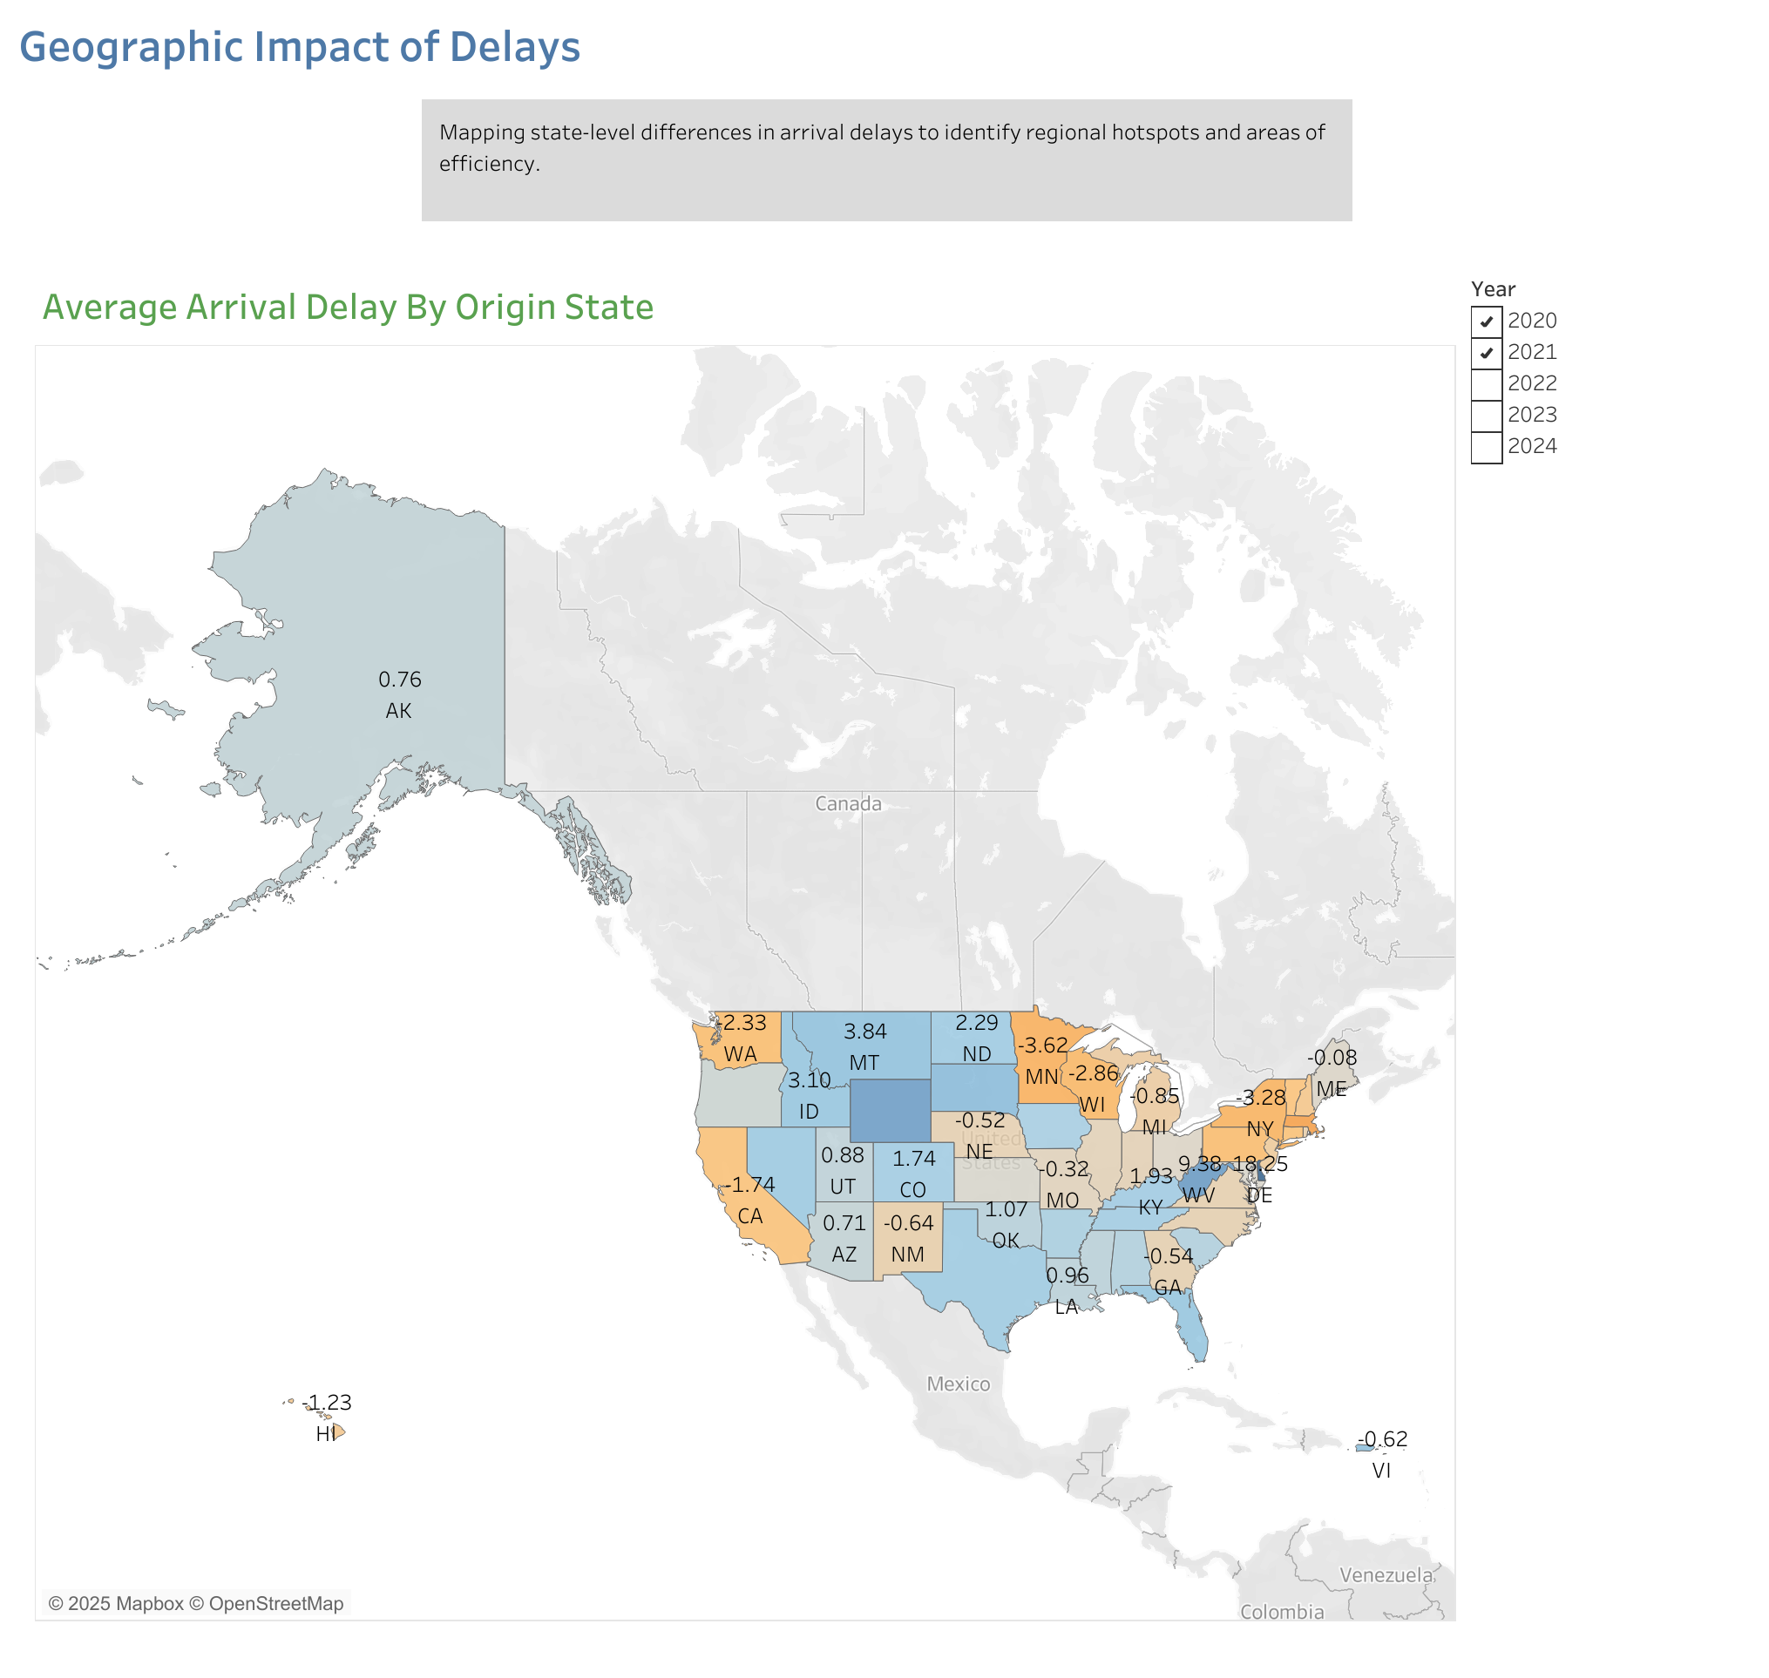
DASHBOARD OVERVIEW

Slide 19
HOTSPOT ANALYSIS: K-MEANS CLUSTERING

Slide 20
HOTSPOT ANALYSIS: K-MEANS CLUSTERING
OBJECTIVE:
Segment flight segments/routes based on delay behavior and operational attributes
Discover delay-prone clusters to support targeted interventions
FEATURE SELECTION:
Categorical: Reporting_Airline, Origin, Dest, DayOfWeek, Season, Month
Categorical features were encoded using StringIndexer
Numeric: DelayedFlights, AvgDepDelay, AvgArrDelay, WeatherDelay, NASDelay, CarrierDelay, LateAircraftDelay
PREPROCESSING STEPS:
Aggregated data by route/airline/day/season combinations
Imputed missing values with 0 (nulls for no delays)
Normalized numeric features using StandardScaler
Assembled all features into a single vector for modeling

Slide 21
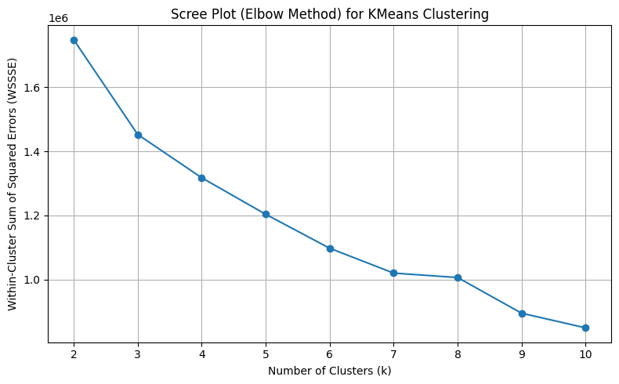
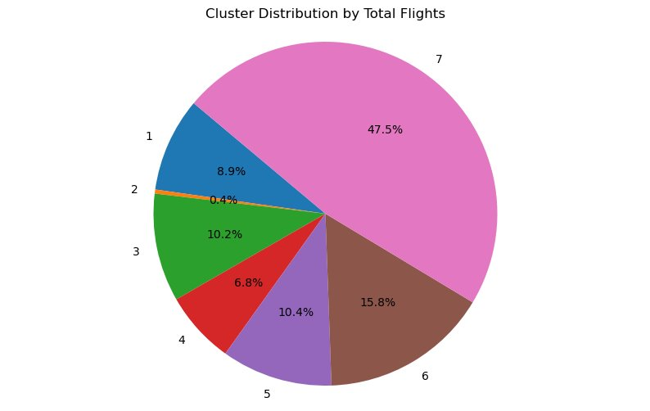
HOTSPOT ANALYSIS: K-MEANS CLUSTERING
MODEL TRAINING (PYSPARK)
Used KMeans from pyspark.ml.clustering
Tried values of k = 2 to 10
Elbow Curve (k vs. WSSSE) to select optimal k = 7
The cluster distribution shows uneven distribution of clusters
We group some clusters based on their %delayed flights and average arrival delay

Slide 22
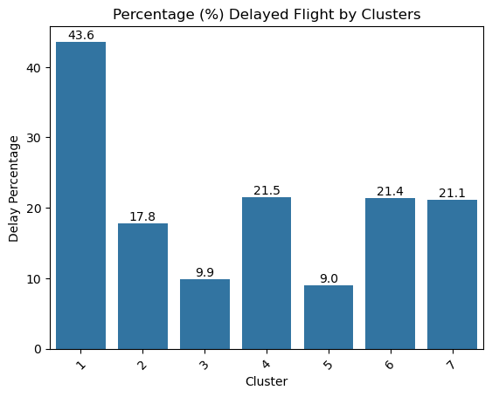
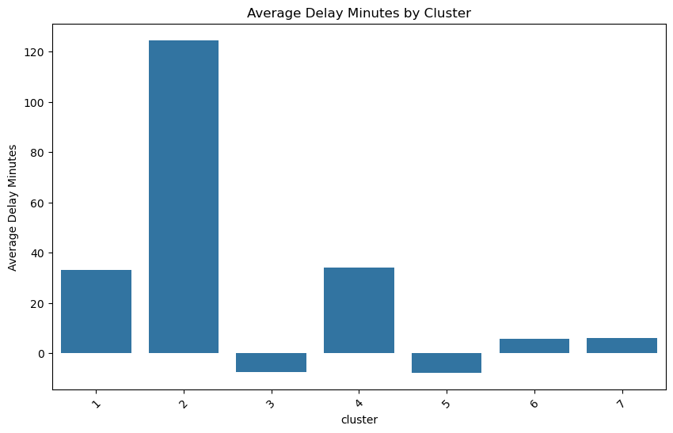
CLUSTER ANALYSIS
Based on above insights Clusters are grouped as follows:
Group A : Cluster 1 and 2
Group B : Cluster 3 and 5
Group C : Cluster 4
Group D : Cluster 6 and 7

Slide 23
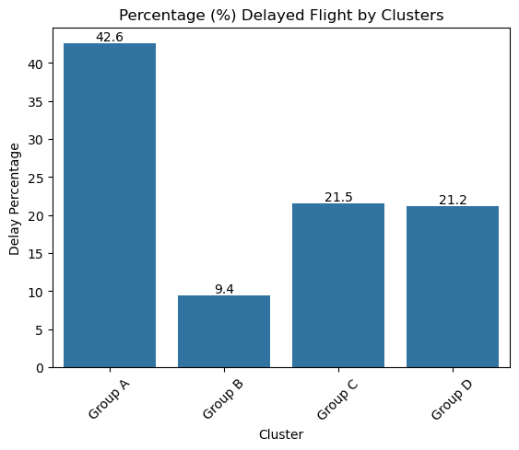
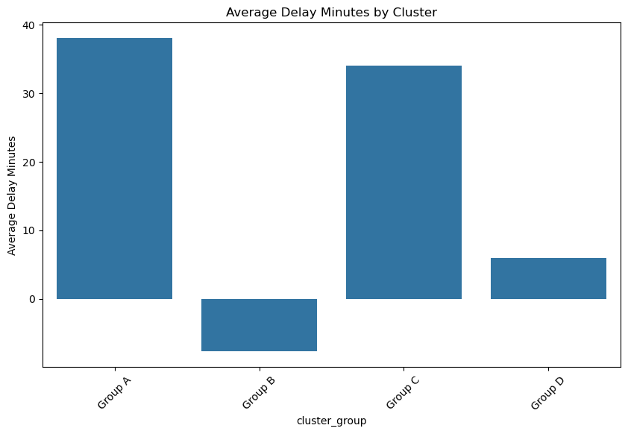
CLUSTER INSIGHTS
Group A : Highest Delay Rate (43%) and Highest Avg Delay (38 mins)
Group B : Efficient and Ahead of Schedule
Group C : Moderate Delay Rate (21%) and High Avg Delay (35 mins)
Group D : Moderate Delay Rate and Low Avg Delay (~5mins)

Slide 24
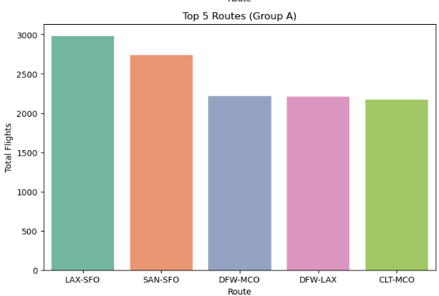
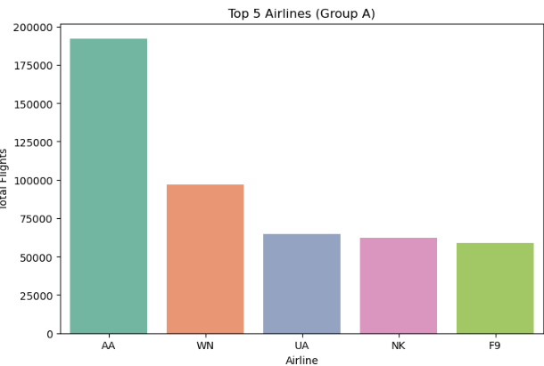
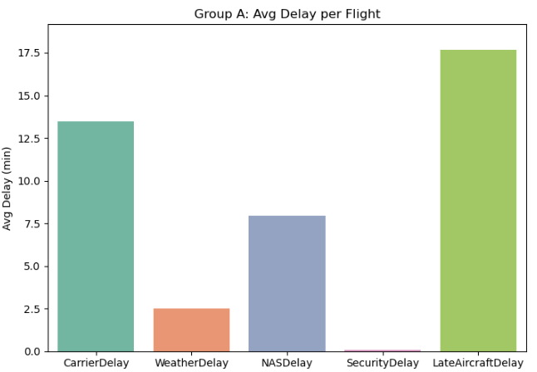
GROUP A: SMALL (9%) BUT HIGHLY DISRUPTED
Represents ~9% of total flights
Has the highest proportion of delayed flights (42%)
Driven heavily by late aircraft and carrier delays
Likely includes operationally complex or congested routes
High per-flight delay despite low traffic
Prioritize schedule reliability and buffer planning in Group A routes

Slide 25
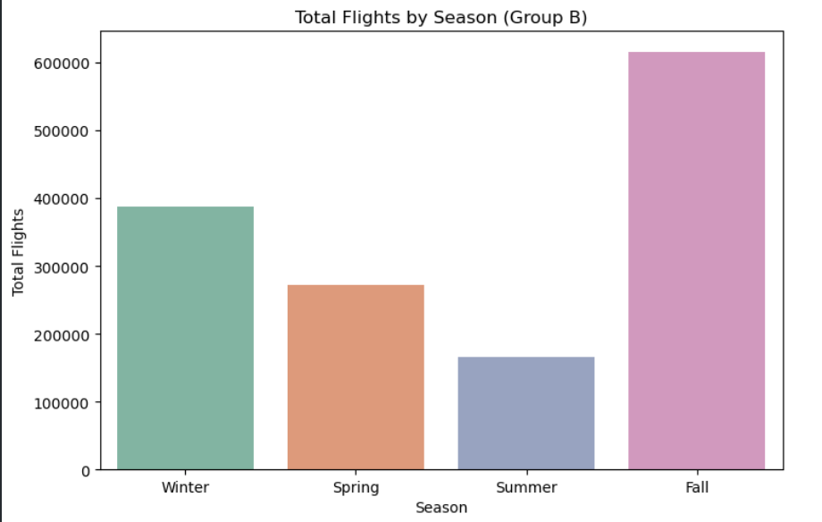
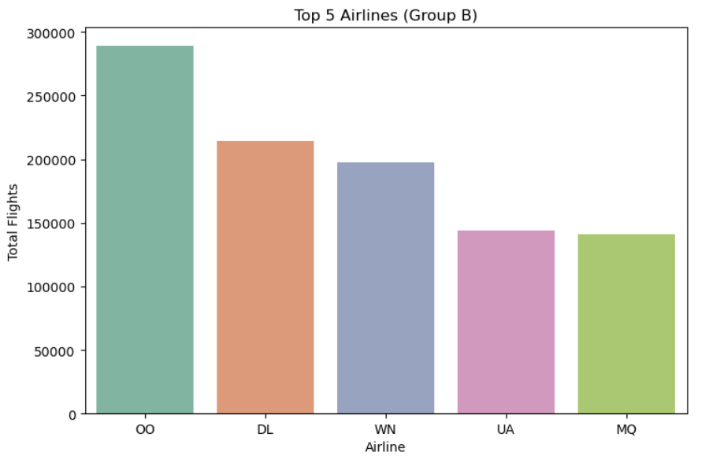
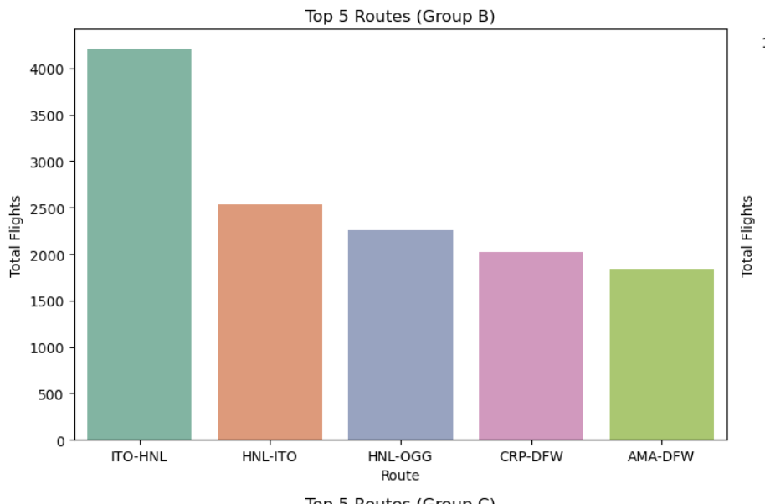
GROUP B: EFFICIENT AND OFTEN AHEAD OF SCHEDULE
~25% of flights, but many arrive early
Operationally efficient; likely includes short-haul or padded-schedule flights
Top carriers: Southwest (WN), Delta (DL), American (AA)
High in Fall (35%) and Winter (31%), showing seasonal resilience
Strong performance across both weekdays and weekends.
Use Group B as a benchmark to optimize schedule design

Slide 26
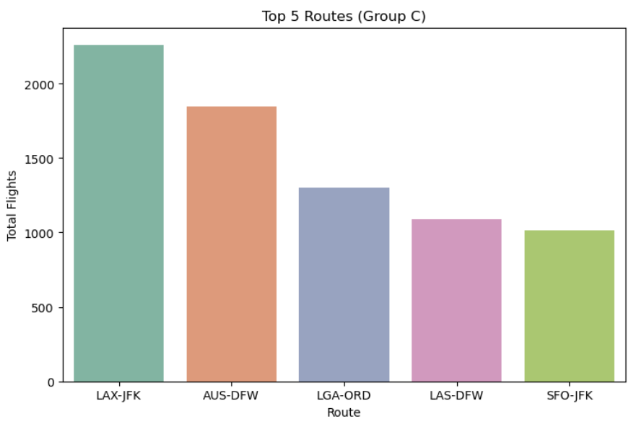
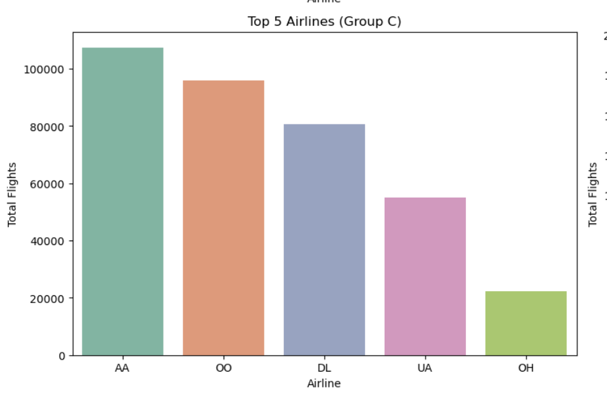
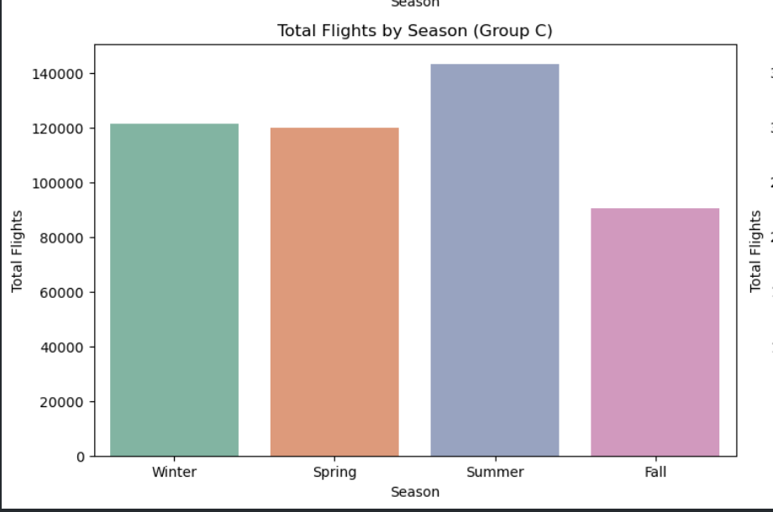
GROUP C: MODERATE DELAY RATE AND DELAY TIMES
~20% of flights delayed
But when flights are delayed, they're delayed significantly
Suggests infrequent, long-haul, or tightly scheduled routes with poor recovery options
Spring-heavy (32%), and slightly more weekend flights (53%)
Top airlines: Delta (DL), Alaska (AS), Southwest (WN)
Route examples likely include complex or less frequently served corridors
Introduce recovery buffers or smarter resource allocation

Slide 27
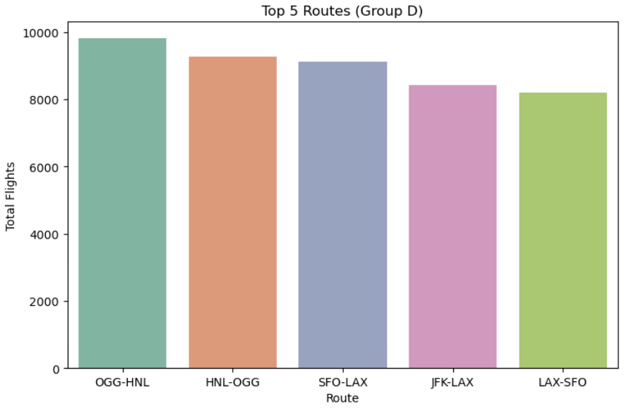
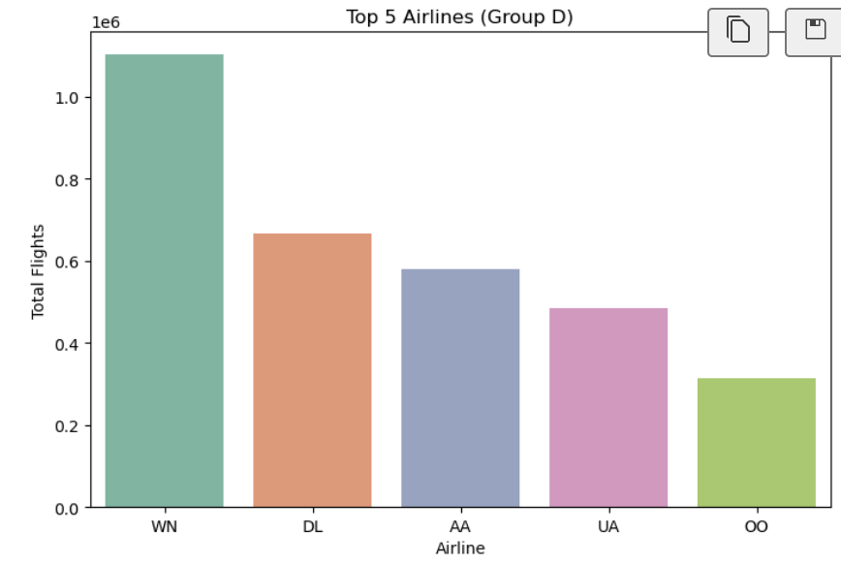
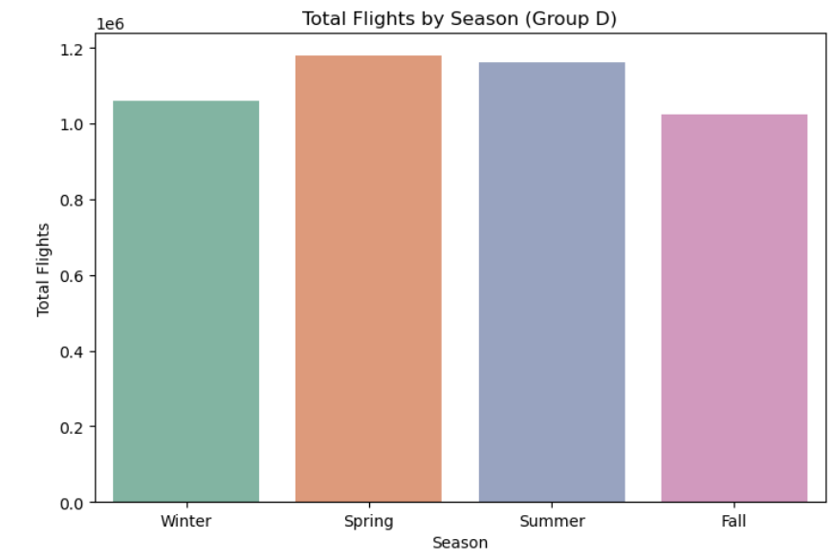
GROUP D: THE WORKHORSE THAT DELIVERS
Handles 63% of all flights the operational backbone
21% delayed flights, but with ~5mins delay
Indicates efficient handling of large-scale operations
Likely includes frequent hub-to-hub or short-haul business routes
Balanced weekday/weekend share, and active in Spring/Fall
Top carriers: American (AA), Delta (DL), Alaska (AS)
Template for scaling best practices across the entire network.

Slide 28
IMPACT OF WEATHER ON DELAY
We integrated hourly weather data using the Meteostat API to enrich our flight dataset
Weather parameters retrieved included:
Wind speed, precipitation, temperature, and weather conditions (rain, fog, etc.)
For each flight, we extracted origin and destination weather conditions at the scheduled departure and arrival times
DATA JOIN STRATEGY:
Date of the flight
Scheduled departure/arrival hour
Airport location (via IATA code → latitude & longitude mapping)

Slide 29
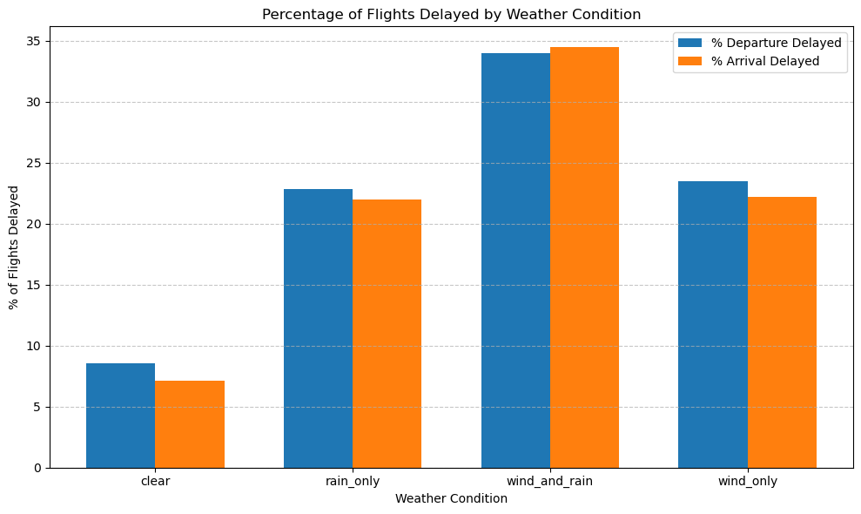
INSIGHTS
Clear weather leads to the lowest delays, with only ~9% departure and ~7% arrival delays
Rain and Wind combined cause the most disruption, both departure and arrival delays spike to nearly ~34%
Wind and Rain alone cause similar levels of disruption: results in ~22%–23% of delay
Wind appears to have a slightly greater impact than rain on departure delays
Departure delays are consistently higher than arrival delays under all weather conditions indicates weather causes more disruption during takeoff than landing

Slide 30
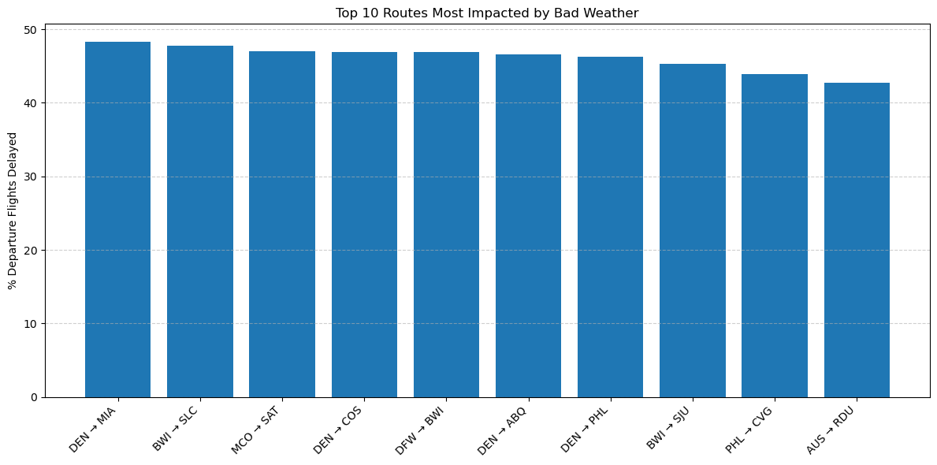
ROUTES MOST AFFECTED BY BAD WEATHER
Denver (DEN) is most impacted
4 out of the top 10 routes originate from Denver
Suggests Denver is a major weather-sensitive hub, likely due to high-altitude and volatile mountain weather patterns
The route DEN → MIA is the most affected, with nearly 48.3% delayed departures during bad weather

Slide 31
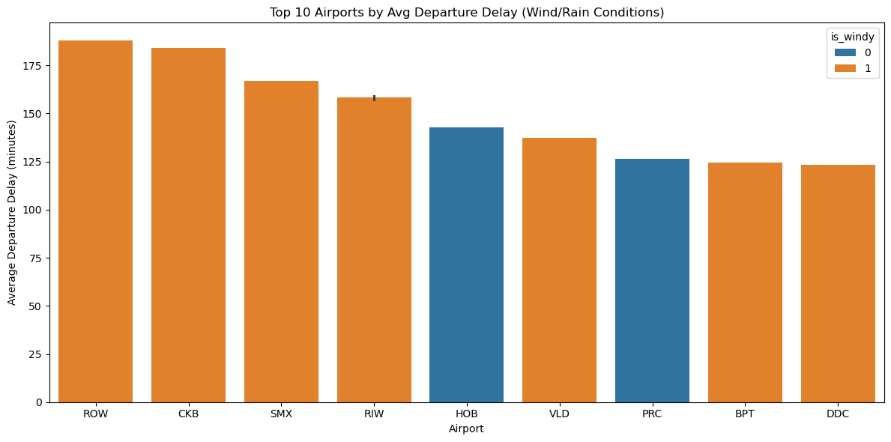
TOP 10 AIRPORTS BY AVG DEPARTURE DELAY
Windy conditions clearly dominate, out of the top 10 delay-prone airports have is_windy = 1
Windy airports dominate delays - 80% of top delay-prone airports show wind as a key weather factor
Not all delays are weather-driven - Airports like HOB show that calm weather does not guarantee on-time departures
HOB (Hobbs, NM) and PRC (Prescott, AZ) show high delays despite not being windy, indicates non-weather factors (e.g., airport capacity, equipment, airline policy) might be contributing

Slide 32
FLIGHT DELAY PREDICTION MODEL (PYSPARK)
Predict whether a flight route is likely to be delayed due to weather using Spark MLlib
We used Logistic Regression, built using a PySpark ML pipeline
FEATURES:
Target Variable: weather_delay_flag1 (binary)
Feature Variables:
Origin and Destination (encoded)
Wind and rain conditions at both airports
Total number of flights on the route
DATASET:
Data Split: 80% training and 20% testing

Slide 33
FLIGHT DELAY PREDICTION MODEL (PYSPARK)
We trained the model using historical flight and weather data
EACH RECORD INCLUDED:
The flight route (origin and destination)
Weather conditions at both airports (wind, rain)
Whether a weather-related delay occurred
RESULT: We achieved an accuracy of 88% , so we can predict flight delays due to weather
REAL-WORLD USE CASE:
If we have upcoming flight schedules and access to forecasted weather conditions, this model can be used to predict delays ahead of time, allowing airlines to take early action and improve overall operations

Slide 34
CONCLUSION
Through extensive analysis of over 31 million flight records and weather data from 2020 to 2024, we uncovered critical insights into the nature and causes of flight delays. Our key findings include:
Delay Hotspots: Certain airports and routes consistently show high delay rates, with Morgantown (MGW) and JetBlue (B6) among the most affected.
Root Causes: Late aircraft and carrier-related issues are the leading contributors to delays, followed by airspace and weather disruptions.
Time Patterns: Delays peak during late night and early morning hours, highlighting systemic scheduling challenges
Clustering Insights: K-means clustering revealed distinct delay behavior groups, with Group A needing urgent attention and Group B setting a benchmark for punctuality
Weather conditions have a clear impact on delays, clear skies result in fewer disruptions, while wind and especially the combination of wind and rain significantly increase the likelihood of delays
By leveraging distributed computing (Spark) and HDFS/AWS S3 for scalable processing, our study delivers actionable intelligence to help airlines, airports, and regulators enhance operational efficiency and passenger satisfaction.
Code Repository : GitHub – Airline Delay Analysis

Slide 35
FUTURE SCOPE
REAL-TIME DELAY PREDICTION
Integrate streaming data (e.g., from ADS-B or FAA APIs) to build real-time delay forecasting models
ENHANCED WEATHER INTEGRATION
Use more granular weather data (e.g., hourly METAR/TAF) for finer analysis of disruption patterns
PASSENGER IMPACT ANALYSIS
Assess delays from a passenger-centric view — missed connections, rebooking patterns, and satisfaction
DELAY CAUSE ATTRIBUTION USING NLP
Analyze flight logs, airline announcements, or NOTAMs using Natural Language Processing to better classify and understand delay reasons

Slide 36
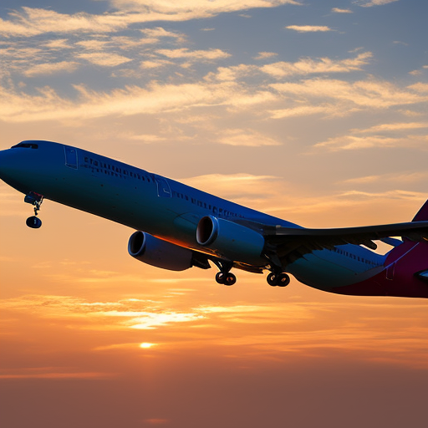
THANK YOU
Q&A

